Slide 1
Super Market Billing system
Presented by:
Aditya S PL0621094
Jeeva k PL0621095
Ramya V PL0621107
Nihal basha SK PL0621101
Somasekhar R PL0621124
Arifuneesa SK PL0621127
Vinay Teja K PL0621116

Slide 2
CONTENTS
Introduction
Existing System
Proposed System
Overview
Module
System Design
Conclusion

Slide 3
Introduction
Super market billing system is an application whose primary function is to assist the people in the supermarket. It does that by automating the store. People using this application can avoid manual bill making and can get rid of maintaining heaps of bills.

Slide 4
Existing System
Many Supermarkets use this type of billing system. It has been improved according to the requirements of sellers and customers. It does the same work that is calculating the bill, gives it to the customer and maintains a proper database and also generates records. A new concept is added in the billing system which also maintains relationships with the customers who purchase more products regularly, so that System gives them more commission.

Slide 5
Limitations of Existing System
Processing Speed: Processing speed of the software is not so good to operate fast.
Flexibility: Existing system is not so flexible that it can be changed according to the operators and customers.
Man Power: Existing System uses so many people to operate the system.

Slide 6
Proposed System
This system will address all the drawbacks of the existing system and also improves some of them to an extinct. It is a sophisticated method in contrast to the existing system.

Slide 7
Advantages of Proposed System
There are many advantages to the proposed system which are listed below
Reduction in processing cost.
Improve reporting.
Ability to meet user requirements.
Flexibility.
Reduction in usage of storage space.
Faster response time

Slide 8
Advantages of Proposed System
Reduction in Manpower.
Automatic production of the documents and Reports
Ability to meet user requirements.
Reduction in usage of storage space.
Faster response time

Slide 9
Overview
In this project there are two sections: administrator and customer. On the customer side only information is passed and saved as a record. On the administrator side there are five modules which have their functionalities and will perform in order to run the application. On the administration side there will be two or more operators, one is admin and the rest are billing operators. Each of them has to login with their credentials to access the application, which makes it secure from any unwanted users.

Slide 10
Workflow
In workflow we will go through the process involved in supermarkets from arrival of the product step by step
Arrival of the product to the store
Registering the product in the database. Done by the operator.
Taxes and commissions for each product entered by the admin.
Customers will take the products for billing.
Operator will bill the products.
After payment the bill will be generated based on product ids.

Slide 11
Technologies used
JSP and Spring Boot with MVC
Software Used: Windows 10

Slide 12
MODULES
Admin module
Cashier module

Slide 13
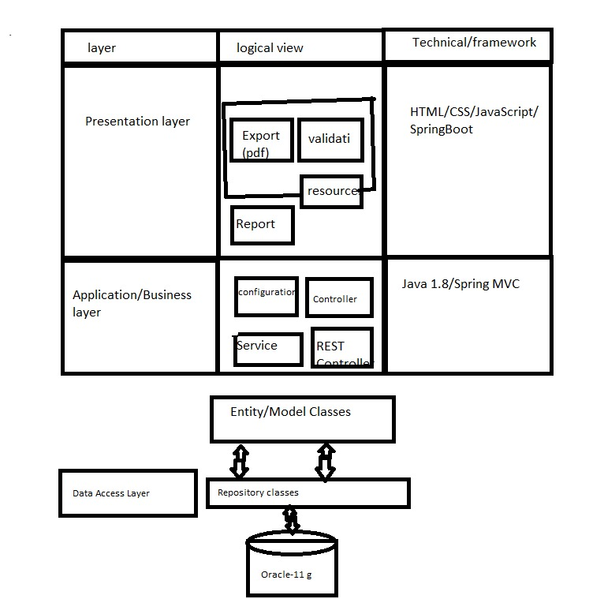
SYSTEM DESIGN
Architecture Diagram
Architecture Diagram:

Slide 14
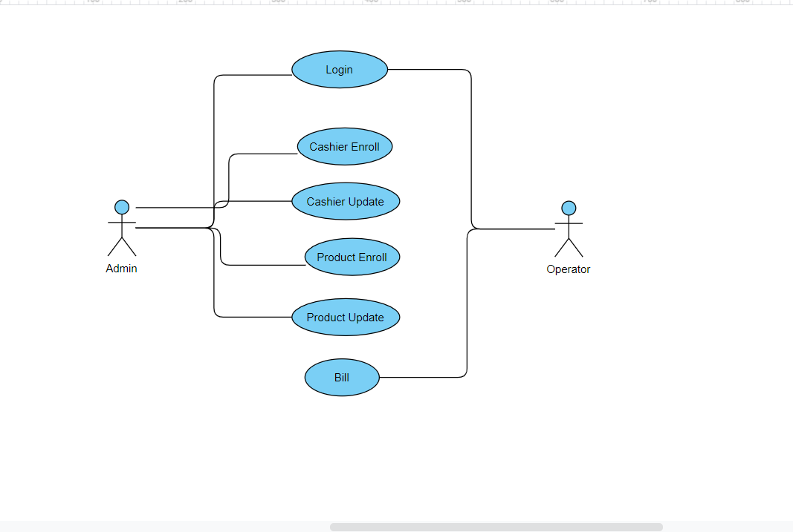
2) Use case Diagram

Slide 15
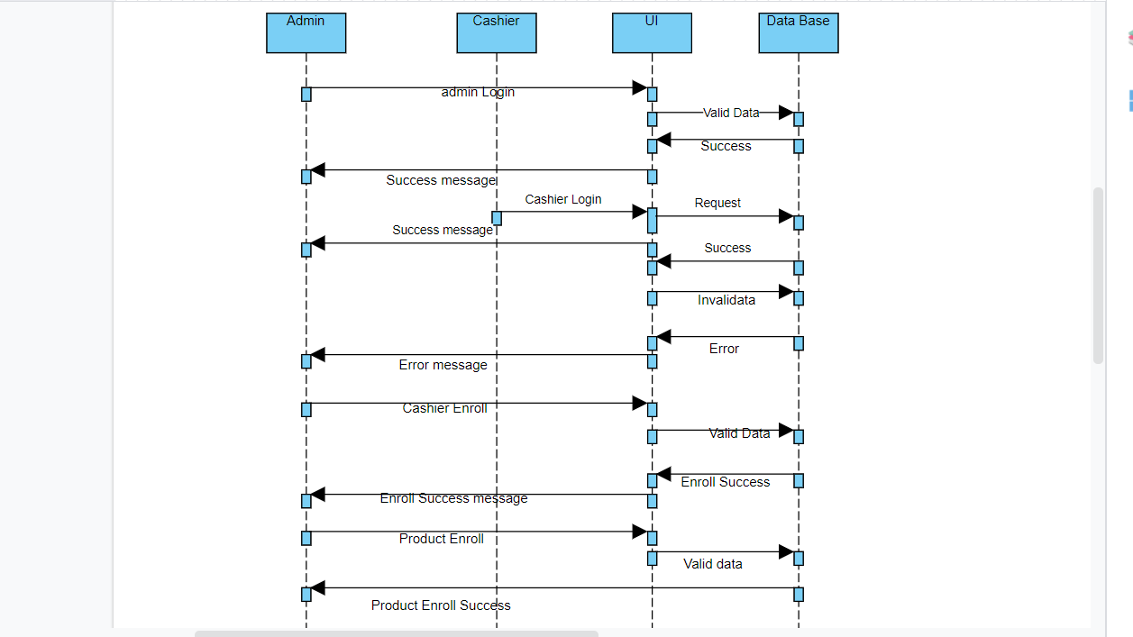
3) Sequence diagram

Slide 16
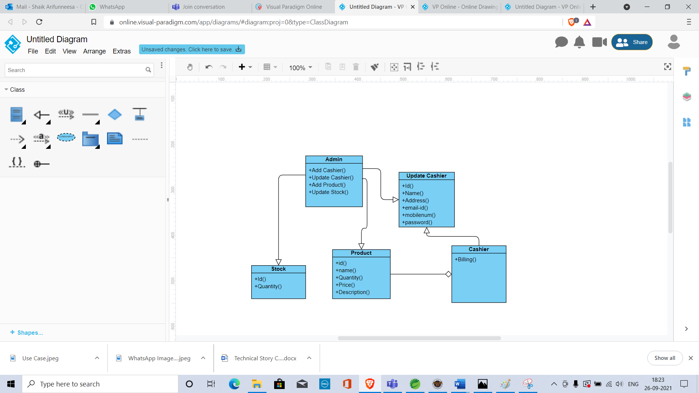
4) Class diagram

Slide 17
implementation
There are two modules in this application
Admin
Cashier
Admin: Admin has to login using his login credentials to be able to use the application.
Then he will have some operations under him such as enrolling cashier, updating stock.
Cashier: Cashier also should login using his credentials as admin does. His operations are billing and saving customer details.

Slide 18
conclusion
Supermarket Billing System has to do with making appropriate effort to stop the rising problem to all manual supermarket operation in order to enhance the operation of such supermarket. In this project, the software or system that can be used to aid all supermarkets that is still operating manually have been successfully developed.

